Slide 1

Introduction to Probabilistic Machine Learning
Ralf Herbrich, Jakob Walter
Linear Basis Function Models

Slide 2
Overview
Linear Basis Functions Models
Linear Algebra
Vector Spaces
Linear Mappings and Matrices
Matrix Derivatives
Maximum A Posterior Learning and Regularized Least Squares

Slide 3
Overview
Linear Basis Functions Models
Linear Algebra
Vector Spaces
Linear Mappings and Matrices
Matrix Derivatives
Maximum A Posterior Learning and Regularized Least Squares

Slide 4
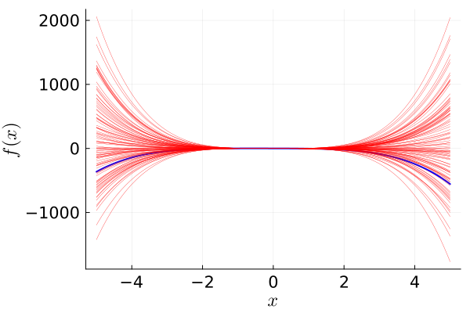
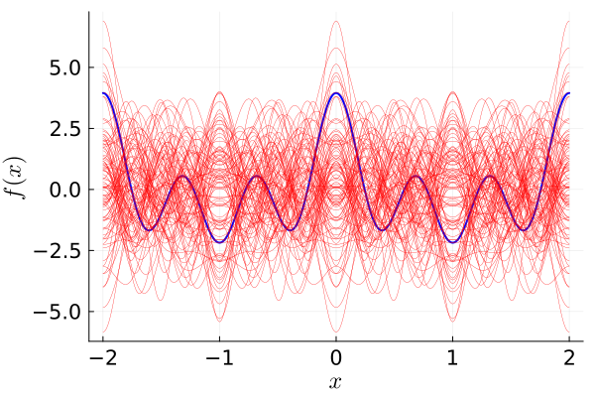
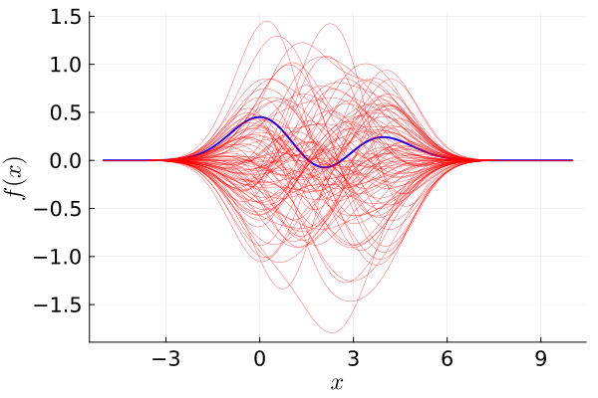
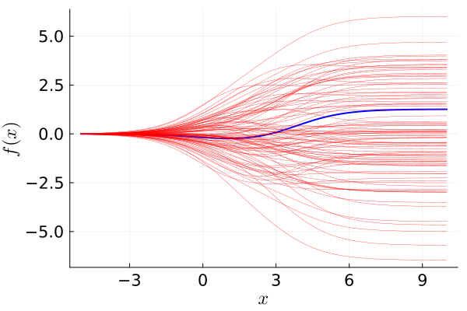
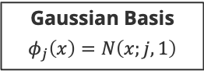
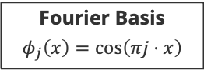
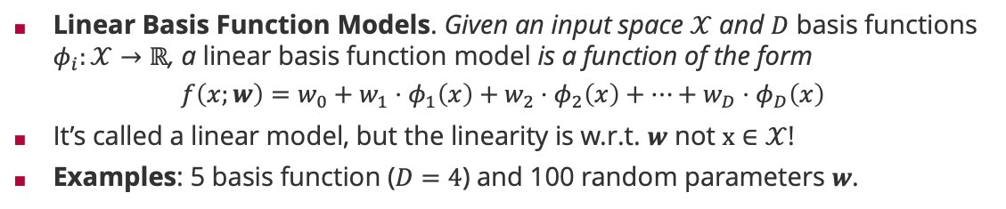
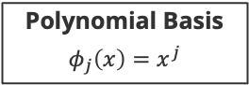
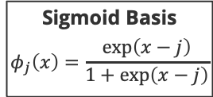
Linear Basis Function Models
Linear Basis Function Models. Given an input space $𝒳$ and $D$ basis functions $φ_{i}:𝒳→ℝ$, a linear basis function model is a function of the form
$$f\left(x;w\right)=w_{0}+w_{1}⋅φ_{1}\left(x\right)+w_{2}⋅φ_{2}\left(x\right)+⋯+w_{D}⋅φ_{D}\left(x\right)$$
It’s called a linear model, but the linearity is w.r.t. $w$ not $x∈𝒳$!
Examples: 5 basis function ($D=4$) and 100 random parameters $w$.
Sigmoid Basis
$$φ_{j}\left(x\right)=\frac{exp\left(x−j\right)}{1+\exp\left(x−j\right)}$$
Polynomial Basis
$$φ_{j}\left(x\right)=x^{j}$$
Fourier Basis
$$φ_{j}\left(x\right)=\cos\left(πj⋅x\right)$$
Gaussian Basis
$$φ_{j}\left(x\right)=N\left(x;j,1\right)$$

Slide 5
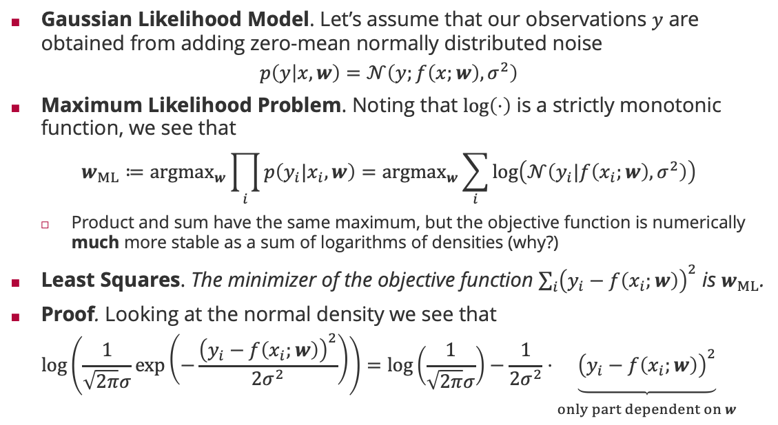
Maximum Likelihood and Least Squares
Gaussian Likelihood Model. Let’s assume that our observations $y$ are obtained from adding zero-mean normally distributed noise
$$p\left(y | x,w\right)=𝒩\left(y;f\left(x;w\right),σ^{2}\right)$$
Maximum Likelihood Problem. Noting that $\log\left(⋅\right)$ is a strictly monotonic function, we see that
$$w_{ML}≔{argmax}_{w}\prod_{i}{p\left(y_{i}|x_{i},w\right)}={argmax}_{w}\sum_{i}{\log\left(𝒩\left(y_{i}|f\left(x_{i};w\right),σ^{2}\right)\right)}$$
Product and sum have the same maximum, but the objective function is numerically much more stable as a sum of logarithms of densities (why?)
Least Squares. The minimizer of the objective function ${\sum_{i}{\left(y_{i}−f\left(x_{i};w\right)\right)}}^{2}$ is $w_{ML}$.
Proof. Looking at the normal density we see that
$$log\left(\frac{1}{\sqrt{2π}σ}\exp\left(−\frac{{\left(y_{i}−f\left(x_{i};w\right)\right)}^{2}}{2σ^{2}}\right)\right)=log\left(\frac{1}{\sqrt{2π}σ}\right)−\frac{1}{2σ^{2}}⋅\underset{\begin{aligned} \\ only part dependent on w\end{aligned}}{\underbrace{{\left(y_{i}−f\left(x_{i};w\right)\right)}^{2}}}$$

Slide 6
Overview
Linear Basis Functions Models
Linear Algebra
Vector Spaces
Linear Mappings and Matrices
Matrix Derivatives
Maximum A Posterior Learning and Regularized Least Squares

Slide 7
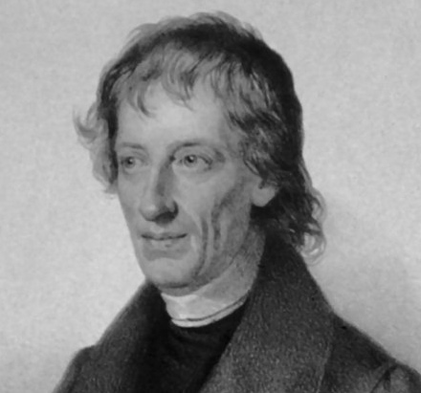
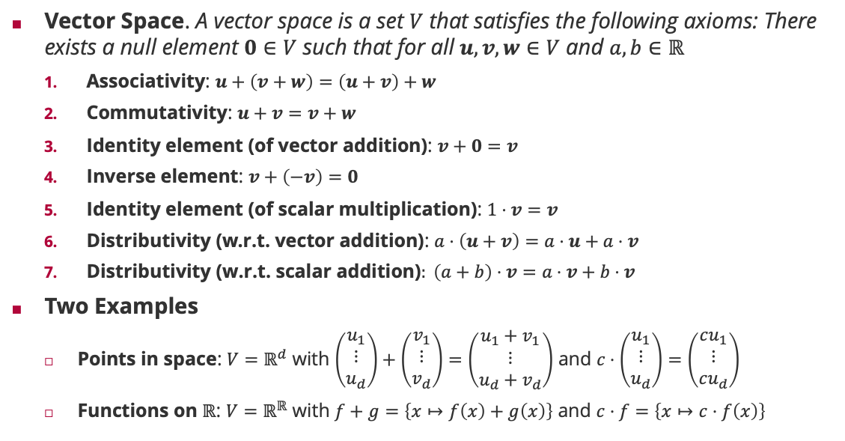
Vector Spaces
Vector Space. A vector space is a set $V$ that satisfies the following axioms: There exists a null element $0∈V$ such that for all $u,v,w∈V$ and $a,b∈ℝ$
Associativity: $u+\left(v+w\right)=\left(u+v\right)+w$
Commutativity: $u+v=v+w$
Identity element (of vector addition): $v+0=v$
Inverse element: $v+\left(−v\right)=0$
Identity element (of scalar multiplication): $1⋅v=v$
Distributivity (w.r.t. vector addition): $a⋅\left(u+v\right)=a⋅u+a⋅v$
$\text{Distributivity}\text{ (}\text{w}\text{.}\text{r}\text{.}\text{t}\text{. }\text{scalar} \text{addition}\text{)}: \left(a+b\right)⋅v=a⋅v+b⋅v$
Two Examples
Points in space: $V=ℝ^{d}$ with $\left(\begin{matrix}u_{1} \\ ⋮ \\ u_{d}\end{matrix}\right)+\left(\begin{matrix}v_{1} \\ ⋮ \\ v_{d}\end{matrix}\right)=\left(\begin{matrix}{u_{1}+v}_{1} \\ ⋮ \\ {u_{d}+v}_{d}\end{matrix}\right)$ and $c⋅\left(\begin{matrix}u_{1} \\ ⋮ \\ u_{d}\end{matrix}\right)=\left(\begin{matrix}cu_{1} \\ ⋮ \\ cu_{d}\end{matrix}\right)$
Functions on $ℝ$: $V=ℝ^{ℝ}$ with $f+g=\left\{x↦f\left(x\right)+g\left(x\right)\right\}$ and $c⋅f=\left\{x↦c⋅f\left(x\right)\right\}$
Bernhard Bolzano (1781 – 1848)

Slide 8
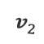
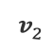
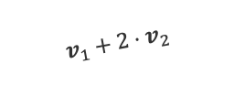
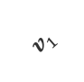
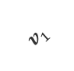
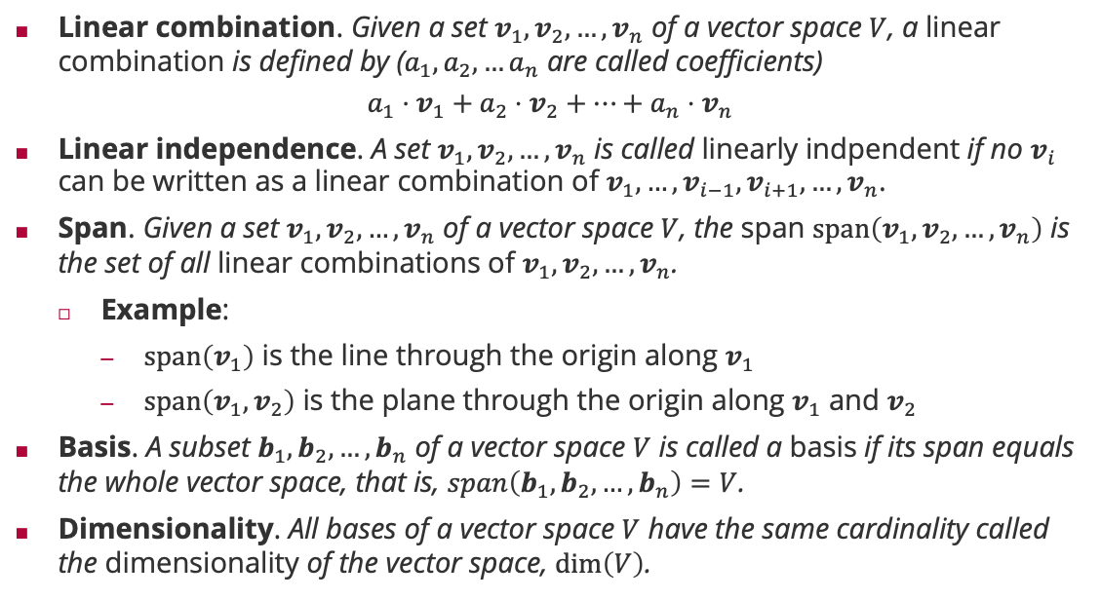
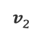
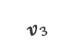
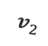
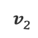
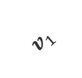
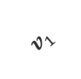
Linear Independence, Span and Basis
$$v_{2}$$
$$v_{2}$$
Linear combination. Given a set $v_{1},v_{2},…,v_{n}$ of a vector space $V$, a linear combination is defined by ($a_{1},a_{2},…a_{n}$ are called coefficients)
$$a_{1}⋅v_{1}+a_{2}⋅v_{2}+⋯+a_{n}⋅v_{n}$$
Linear independence. A set $v_{1},v_{2},…,v_{n}$ is called linearly indpendent if no $v_{i}$ can be written as a linear combination of $v_{1},…,v_{i−1},v_{i+1},…,v_{n}$.
Span. Given a set $v_{1},v_{2},…,v_{n}$ of a vector space $V$, the span $span\left(v_{1},v_{2},…,v_{n}\right)$ is the set of all linear combinations of $v_{1},v_{2},…,v_{n}$.
Example:
$span\left(v_{1}\right)$ is the line through the origin along $v_{1}$
$span\left(v_{1},v_{2}\right)$ is the plane through the origin along $v_{1}$ and $v_{2}$
Basis. A subset $b_{1},b_{2},…,b_{n}$ of a vector space $V$ is called a basis if its span equals the whole vector space, that is, $span\left(b_{1},b_{2},…,b_{n}\right)=V$.
Dimensionality. All bases of a vector space $V$ have the same cardinality called the dimensionality of the vector space, $\dim\left(V\right)$.
$$v_{1}$$
$$v_{1}+2⋅v_{2}$$
$$v_{1}$$
$$v_{1}$$
$$v_{3}$$
$$v_{2}$$
$$v_{2}$$
$$v_{1}$$
$$v_{2}$$

Slide 9
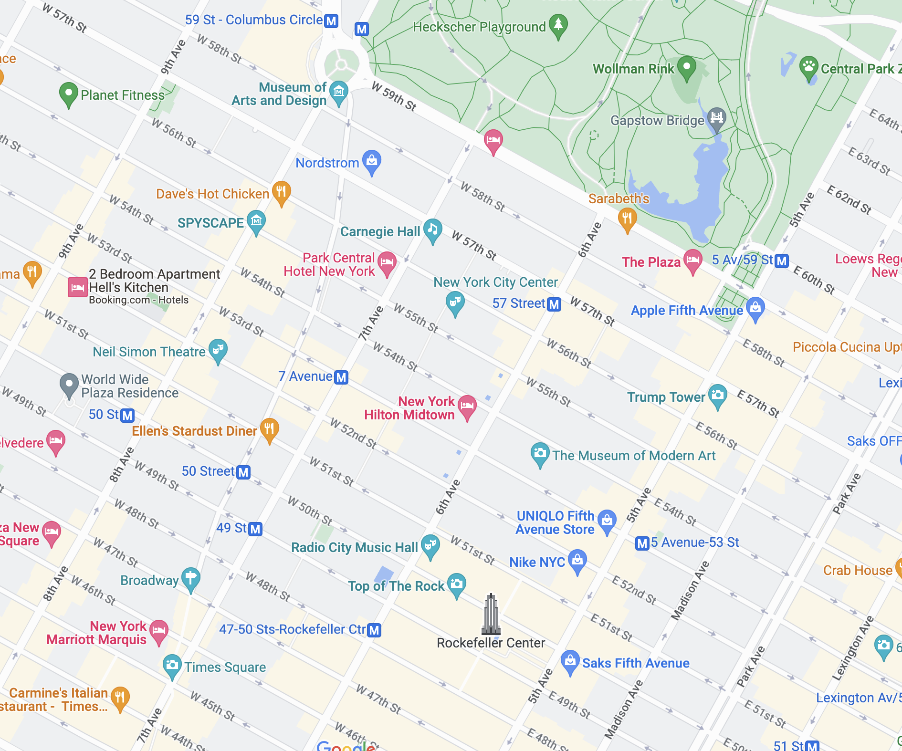
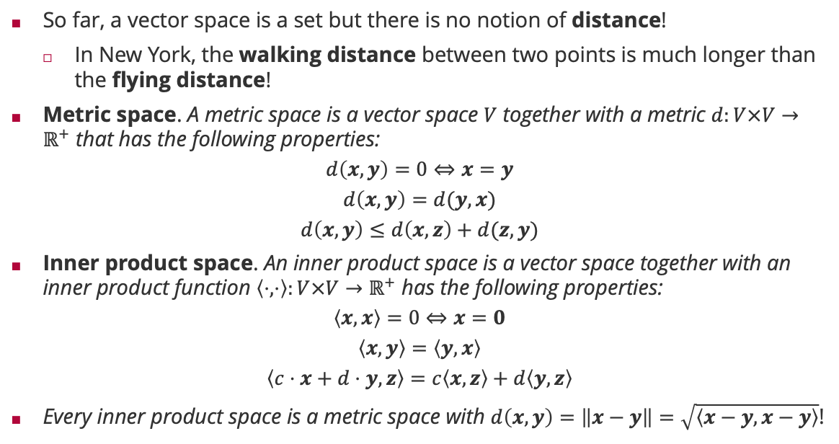
Scalar Products and Inner Product Spaces
So far, a vector space is a set but there is no notion of distance!
In New York, the walking distance between two points is much longer than the flying distance!
Metric space. A metric space is a vector space $V$ together with a metric $d:V×V→ℝ^{+}$ that has the following properties:
$$d\left(x,y\right)=0⇔x=y$$
$$d\left(x,y\right)=d(y,x)$$
$$d\left(x,y\right)≤d\left(x,z\right)+d(z,y)$$
Inner product space. An inner product space is a vector space together with an inner product function $\left\langle ⋅,⋅\right\rangle :V×V→ℝ^{+}$ has the following properties:
$$\left\langle x,x\right\rangle =0⇔x=0$$
$$\left\langle x,y\right\rangle =\left\langle y,x\right\rangle$$
$$\left\langle c⋅x+d⋅y,z\right\rangle =c\left\langle x,z\right\rangle +d\left\langle y,z\right\rangle$$
Every inner product space is a metric space with $d\left(x,y\right)=\left\|x−y\right\|=\sqrt{\left\langle x−y,x−y\right\rangle }$!

Slide 10
Overview
Linear Basis Functions Models
Linear Algebra
Vector Spaces
Linear Mappings and Matrices
Matrix Derivatives
Maximum A Posterior Learning and Regularized Least Squares

Slide 11
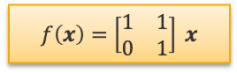
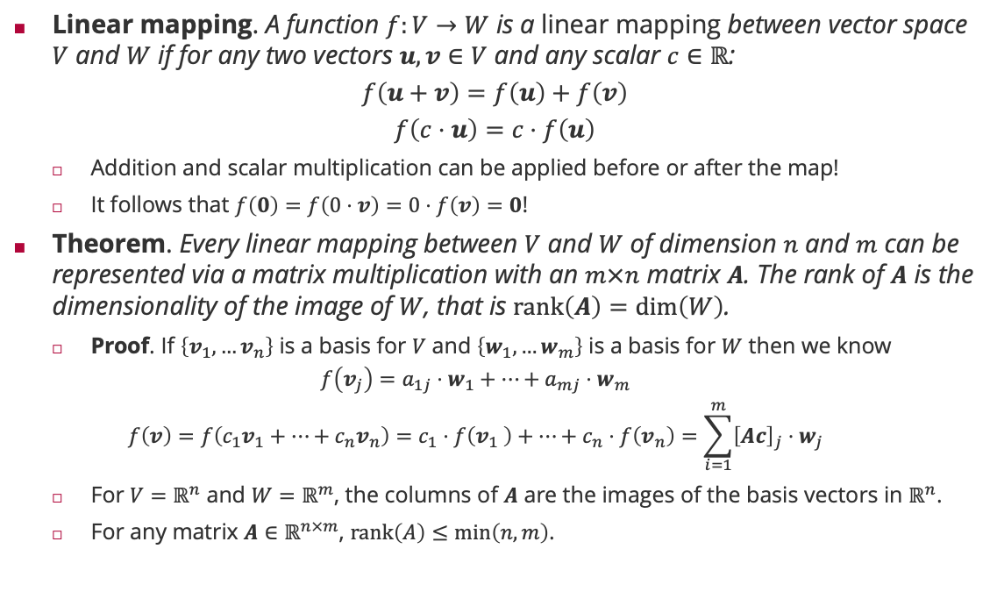
Linear Mappings and Matrices
Linear mapping. A function $f:V→W$ is a linear mapping between vector space $V$ and $W$ if for any two vectors $u,v∈V$ and any scalar $c∈ℝ$:
$$f\left(u+v\right)=f\left(u\right)+f\left(v\right)$$
$$f\left(c⋅u\right)=c⋅f\left(u\right)$$
Addition and scalar multiplication can be applied before or after the map!
It follows that $f\left(0\right)=f\left(0⋅v\right)=0⋅f\left(v\right)=0$!
Theorem. Every linear mapping between $V$ and $W$ of dimension $n$ and $m$ can be represented via a matrix multiplication with an $m×n$ matrix $A$. The rank of $A$ is the dimensionality of the image of $W$, that is $rank\left(A\right)=\dim\left(W\right)$.
Proof. If $\left\{v_{1},…v_{n}\right\}$ is a basis for $V$ and $\left\{w_{1},…w_{m}\right\}$ is a basis for $W$ then we know
$$f\left(v_{j}\right)=a_{1j}⋅w_{1}+⋯+a_{mj}⋅w_{m}$$
$$f\left(v\right)=f\left(c_{1}v_{1}+⋯+c_{n}v_{n}\right)=c_{1}⋅f\left(v_{1} \right)+⋯+c_{n}⋅f\left(v_{n}\right)=\sum_{i=1}^{m}{{\left[Ac\right]}_{j}⋅w_{j}}$$
For $V=ℝ^{n}$ and $W=ℝ^{m}$, the columns of $A$ are the images of the basis vectors in $ℝ^{n}$.
For any matrix $A∈ℝ^{n×m}$, $rank\left(A\right)≤\min\left(n,m\right)$.
$$f\left(x\right)=\left[\begin{matrix}1 & 1 \\ 0 & 1\end{matrix}\right] x$$

Slide 12
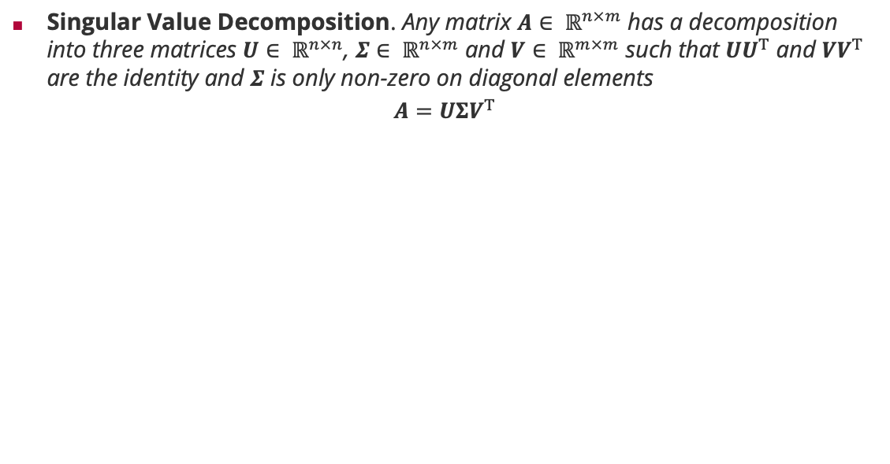




Singular Value Decomposition
Singular Value Decomposition. Any matrix $A∈ ℝ^{n×m}$ has a decomposition into three matrices $U∈ ℝ^{n×n}$, $Σ∈ ℝ^{n×m}$ and $V∈ ℝ^{m×m}$ such that $UU^{T}$ and $VV^{T}$ are the identity and $Σ$ is only non-zero on diagonal elements
$$A=UΣV^{T}$$
$$f\left(x\right)=Ax$$
$$V^{T} x$$
$$UΣV^{T} x$$
$$ΣV^{T} x$$

Slide 13
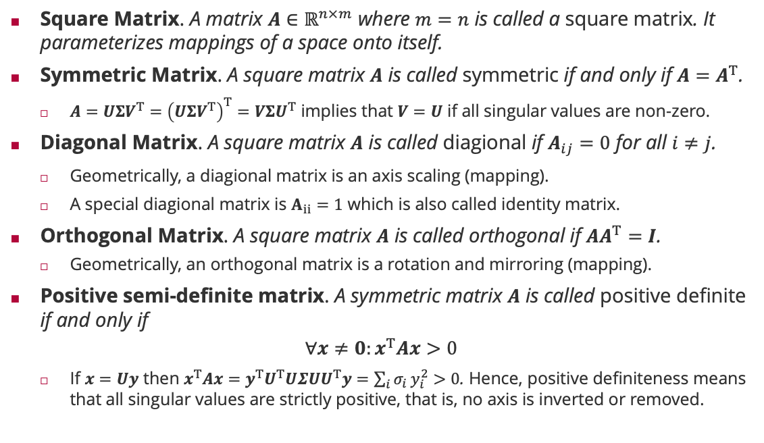
Matrix Types and Properties
Square Matrix. A matrix $A∈ℝ^{n×m}$ where $m=n$ is called a square matrix. It parameterizes mappings of a space onto itself.
Symmetric Matrix. A square matrix $A$ is called symmetric if and only if $A=A^{T}$.
$A=UΣV^{T}={\left(UΣV^{T}\right)}^{T}=VΣU^{T}$ implies that $V=U$ if all singular values are non-zero.
Diagonal Matrix. A square matrix $A$ is called diagional if $A_{ij}=0$ for all $i≠j$.
Geometrically, a diagional matrix is an axis scaling (mapping).
A special diagional matrix is $A_{ii}=1$ which is also called identity matrix.
Orthogonal Matrix. A square matrix $A$ is called orthogonal if ${AA}^{T}=I$.
Geometrically, an orthogonal matrix is a rotation and mirroring (mapping).
Positive semi-definite matrix. A symmetric matrix $A$ is called positive definite if and only if
$$∀x≠0:x^{T}Ax>0$$
If $x=Uy$ then $x^{T}Ax=y^{T}U^{T}UΣUU^{T}y=\sum_{i}{σ_{i}}y_{i}^{2}>0$. Hence, positive definiteness means that all singular values are strictly positive, that is, no axis is inverted or removed.

Slide 14
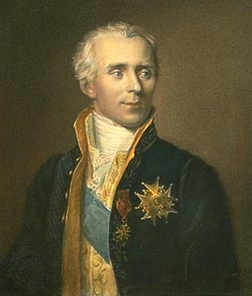
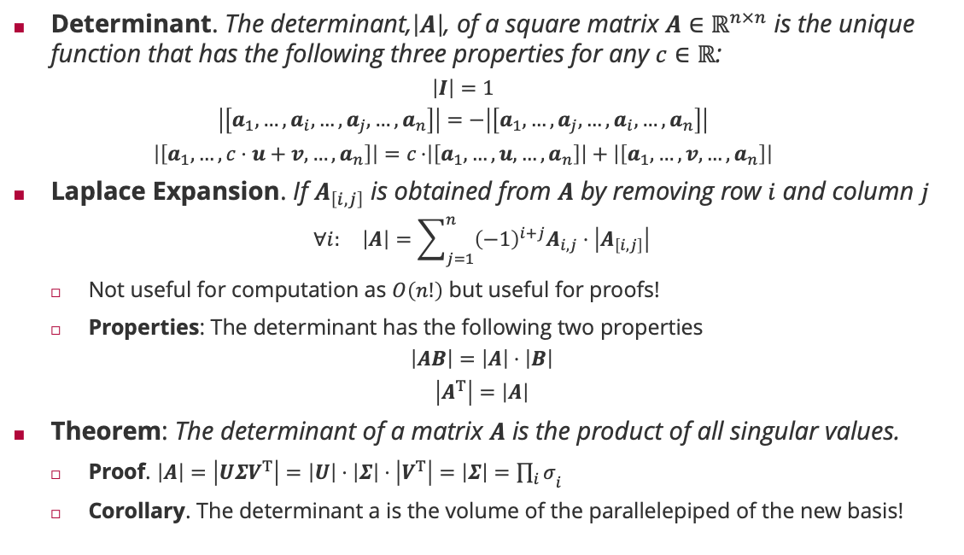
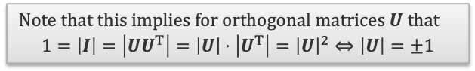
Determinant of a Matrix
Determinant. The determinant,$\left|A\right|$, of a square matrix $A∈ℝ^{n×n}$ is the unique function that has the following three properties for any $c∈ℝ$:
$$\left|I\right|=1$$
$$\left|\left[a_{1},…,a_{i},…,a_{j},…,a_{n}\right]\right|=−\left|\left[a_{1},…,a_{j},…,a_{i},…,a_{n}\right]\right|$$
$$\left|\left[a_{1},…,c⋅u+v, …,a_{n}\right]\right|=c⋅\left|\left[a_{1},…,u, …,a_{n}\right]\right|+\left|\left[a_{1},…,v, …,a_{n}\right]\right|$$
Laplace Expansion. If $A_{\left[i,j\right]}$ is obtained from $A$ by removing row $i$ and column $j$
$$∀i: \left|A\right|=\sum_{j=1}^{n}{{\left(−1\right)}^{i+j}A_{i,j}⋅\left|A_{\left[i,j\right]}\right|}$$
Not useful for computation as $O\left(n!\right)$ but useful for proofs!
Properties: The determinant has the following two properties
$$\left|AB\right|=\left|A\right|⋅\left|B\right|$$
$$\left|A^{T}\right|=\left|A\right|$$
Theorem: The determinant of a matrix $A$ is the product of all singular values.
Proof. $\left|A\right|=\left|UΣV^{T}\right|=\left|U\right|⋅\left|Σ\right|⋅\left|V^{T}\right|=\left|Σ\right|={\prod_{i}{σ}}_{i}$
Corollary. The determinant a is the volume of the parallelepiped of the new basis!
Pierre-Simon Laplace (1749 – 1827)
Note that this implies for orthogonal matrices $U$that
$$1=\left|I\right|=\left|UU^{T}\right|=\left|U\right|⋅\left|U^{T}\right|={\left|U\right|}^{2}⇔\left|U\right|=±1$$

Slide 15
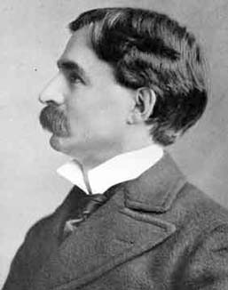

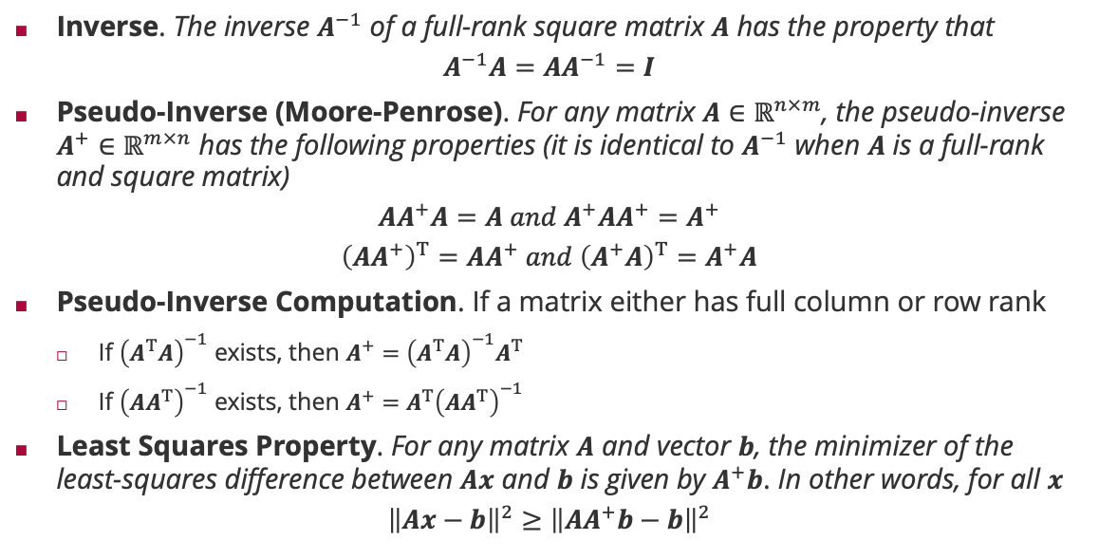
Generalized Inverse of a Matrix
Inverse. The inverse $A^{−1}$ of a full-rank square matrix $A$ has the property that
$$A^{−1}A=AA^{−1}=I$$
Pseudo-Inverse (Moore-Penrose). For any matrix $A∈ℝ^{n×m}$, the pseudo-inverse $A^{+}∈ℝ^{m×n}$ has the following properties (it is identical to $A^{−1}$ when $A$ is a full-rank and square matrix)
$$AA^{+}A=A and A^{+}AA^{+}=A^{+}$$
$${\left(AA^{+}\right)}^{T}=AA^{+} and {\left(A^{+}A\right)}^{T}=A^{+}A$$
Pseudo-Inverse Computation. If a matrix either has full column or row rank
If ${\left(A^{T}A\right)}^{−1}$ exists, then $A^{+}={\left(A^{T}A\right)}^{−1}A^{T}$
If ${\left(AA^{T}\right)}^{−1}$ exists, then $A^{+}={A^{T}\left(AA^{T}\right)}^{−1}$
Least Squares Property. For any matrix $A$ and vector $b$, the minimizer of the least-squares difference between $Ax$ and $b$ is given by $A^{+}b$. In other words, for all $x$
$${\left\|Ax−b\right\|}^{2}≥{\left\|AA^{+}b−b\right\|}^{2}$$
Eliakim Hastings Moore (1862 – 1932)
Sir Roger Penrose (1931 – )

Slide 16

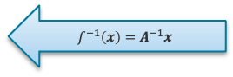
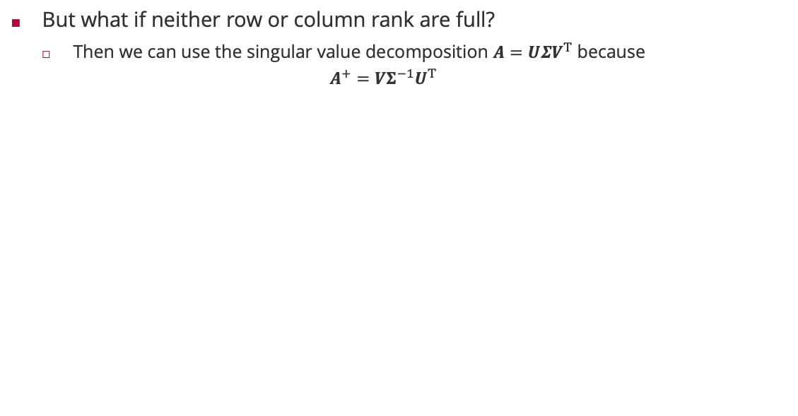


Generalized Inverse of a Matrix (SVD)
But what if neither row or column rank are full?
Then we can use the singular value decomposition $A=UΣV^{T}$ because
$$A^{+}=VΣ^{−1}U^{T}$$
$$f\left(x\right)=Ax$$
$$f^{−1}\left(x\right)=A^{−1}x$$
$${{VΣ}^{−1}U}^{T} x$$
$$U^{T} x$$
$$Σ^{−1}U^{T} x$$

Slide 17

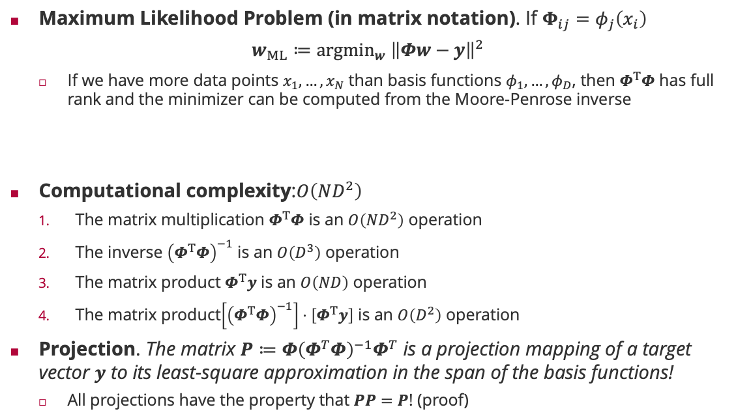
Maximum Likelihood Revisited
Maximum Likelihood Problem (in matrix notation). If $Φ_{ij}=φ_{j}\left(x_{i}\right)$
$$w_{ML}≔{argmin}_{w} {\left\|Φw−y\right\|}^{2}$$
If we have more data points $x_{1},…,x_{N}$ than basis functions $φ_{1},…,φ_{D}$, then $Φ^{T}Φ$ has full rank and the minimizer can be computed from the Moore-Penrose inverse
Computational complexity:$O\left(ND^{2}\right)$
The matrix multiplication $Φ^{T}Φ$ is an $O\left({ND}^{2}\right)$ operation
The inverse ${\left(Φ^{T}Φ\right)}^{−1}$ is an $O\left(D^{3}\right)$ operation
The matrix product $Φ^{T}y$ is an $O\left(ND\right)$ operation
The matrix product$\left[{\left(Φ^{T}Φ\right)}^{−1}\right]⋅\left[Φ^{T}y\right]$ is an $O\left(D^{2}\right)$ operation
Projection. The matrix $P≔{Φ\left(Φ^{T}Φ\right)}^{−1}Φ^{T}$ is a projection mapping of a target vector $y$ to its least-square approximation in the span of the basis functions!
All projections have the property that $PP=P$! (proof)
$${w_{ML}=\left(Φ^{T}Φ\right)}^{−1}Φ^{T}y$$

Slide 18
Overview
Linear Basis Functions Models
Linear Algebra
Vector Spaces
Linear Mappings and Matrices
Matrix Derivatives
Maximum A Posterior Learning and Regularized Least Squares

Slide 19
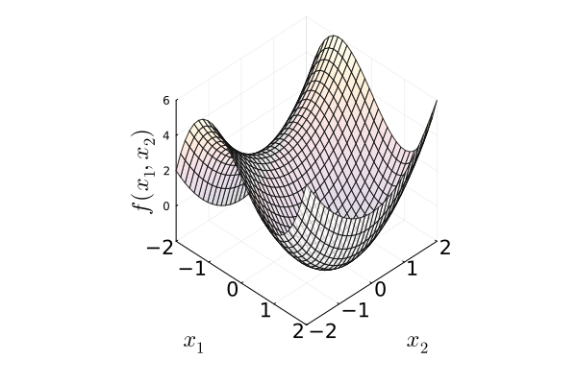
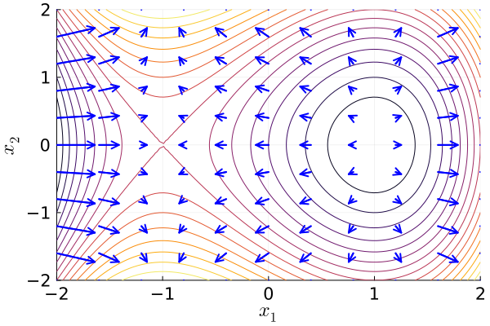
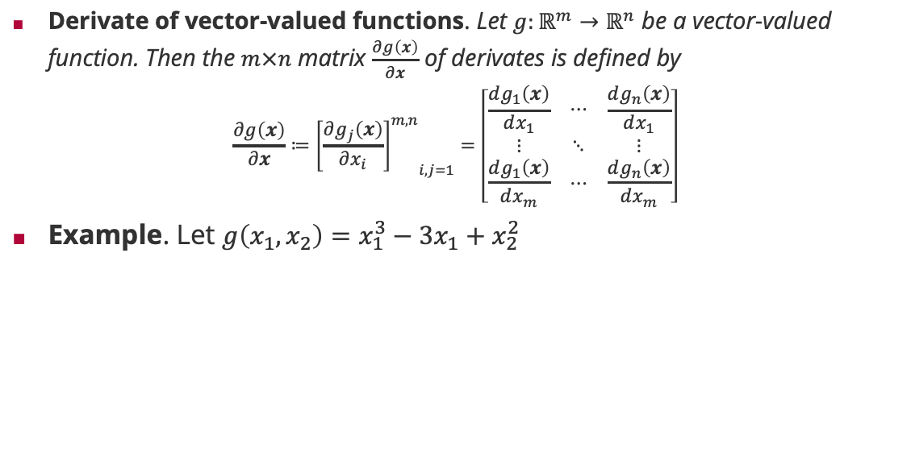
Derivates of vector-valued Functions
Derivate of vector-valued functions. Let $g:ℝ^{m}→ℝ^{n}$ be a vector-valued function. Then the $m×n$ matrix $\frac{∂g\left(x\right)}{∂x}$ of derivates is defined by
$$\frac{∂g\left(x\right)}{∂x}≔{{\left[\frac{∂g_{j}\left(x\right)}{∂x_{i}}\right]}^{m,n}}_{i,j=1}=\left[\begin{matrix}\frac{dg_{1}\left(x\right)}{dx_{1}} & ⋯ & \frac{dg_{n}\left(x\right)}{dx_{1}} \\ ⋮ & ⋱ & ⋮ \\ \frac{dg_{1}\left(x\right)}{dx_{m}} & ⋯ & \frac{dg_{n}\left(x\right)}{dx_{m}}\end{matrix}\right]$$
Example. Let $g\left(x_{1},x_{2}\right)=x_{1}^{3}−3x_{1}+x_{2}^{2}$

Slide 20
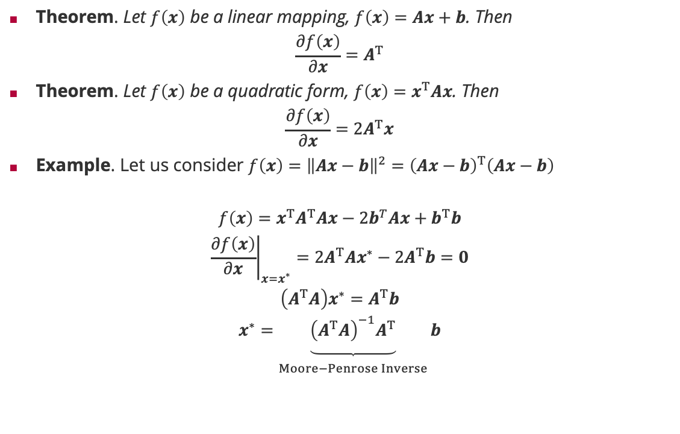
Derivates of Linear Mappings
Theorem. Let $f\left(x\right)$ be a linear mapping, $f\left(x\right)=Ax+b$. Then
$$\frac{∂f\left(x\right)}{∂x}=A^{T}$$
Theorem. Let $f\left(x\right)$ be a quadratic form, $f\left(x\right)=x^{T}Ax$. Then
$$\frac{∂f\left(x\right)}{∂x}=2A^{T}x$$
Example. Let us consider $f\left(x\right)={\left\|Ax−b\right\|}^{2}={\left(Ax−b\right)}^{T}\left(Ax−b\right)$
$$f\left(x\right)=x^{T}A^{T}Ax−2b^{T}Ax+b^{T}b$$
$${\left.\frac{∂f\left(x\right)}{∂x}\right|}_{x=x^{∗}}=2A^{T}Ax^{∗}−2A^{T}b=0$$
$$\left(A^{T}A\right)x^{∗}=A^{T}b$$
$$x^{∗}=\underset{\begin{aligned} \\ Moore−Penrose Inverse\end{aligned}}{\underbrace{{{\left(A^{T}A\right)}^{−1}A}^{T}}}b$$

Slide 21
Overview
Linear Basis Functions Models
Linear Algebra
Vector Spaces
Linear Mappings and Matrices
Matrix Derivatives
Maximum A Posterior Learning and Regularized Least Squares

Slide 22

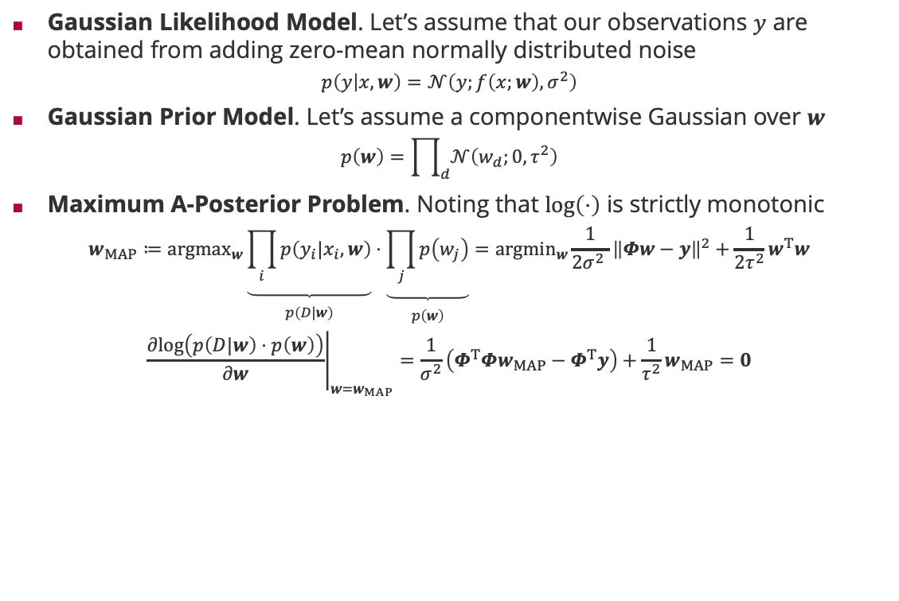
Maximum A Posteriori Learning
Gaussian Likelihood Model. Let’s assume that our observations $y$ are obtained from adding zero-mean normally distributed noise
$$p\left(y | x,w\right)=𝒩\left(y;f\left(x;w\right),σ^{2}\right)$$
Gaussian Prior Model. Let’s assume a componentwise Gaussian over $w$
$$p\left(w\right)=\prod_{d}{𝒩\left(w_{d};0,τ^{2}\right)}$$
Maximum A-Posterior Problem. Noting that $\log\left(⋅\right)$ is strictly monotonic
$$w_{MAP}≔{argmax}_{w}\underset{\begin{aligned} \\ p\left(D|w\right)\end{aligned}}{\underbrace{\prod_{i}{p\left(y_{i}|x_{i},w\right)}}}⋅\underset{\begin{aligned} \\ p\left(w\right)\end{aligned}}{\underbrace{\prod_{j}{p\left(w_{j}\right)}}}={argmin}_{w}{\frac{1}{2σ^{2} }\left\|Φw−y\right\|}^{2}+\frac{1}{2τ^{2}}w^{T}w$$
$${\left.\frac{∂log\left(p\left(D|w\right)⋅p\left(w\right)\right)}{∂w}\right|}_{w=w_{MAP}}=\frac{1}{σ^{2}}\left(Φ^{T}Φw_{MAP}−Φ^{T}y\right)+\frac{1}{τ^{2}}w_{MAP}=0$$
$${w_{MAP}=\left(Φ^{T}Φ+\frac{σ^{2}}{τ^{2}}I \right)}^{−1}Φ^{T}y$$

Slide 23
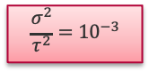
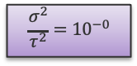
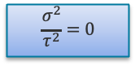
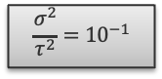
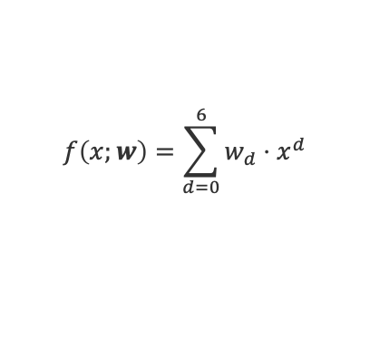
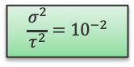
Maximum A Posteriori Learning: Polynomial Regression
$$f\left(x;w\right)=\sum_{d=0}^{6}{w_{d}}⋅x^{d}$$
$$\frac{σ^{2}}{τ^{2}}=0$$
$$\frac{σ^{2}}{τ^{2}}={10}^{−3}$$
$$\frac{σ^{2}}{τ^{2}}={10}^{−2}$$
$$\frac{σ^{2}}{τ^{2}}={10}^{−1}$$
$$\frac{σ^{2}}{τ^{2}}={10}^{−0}$$

Slide 24
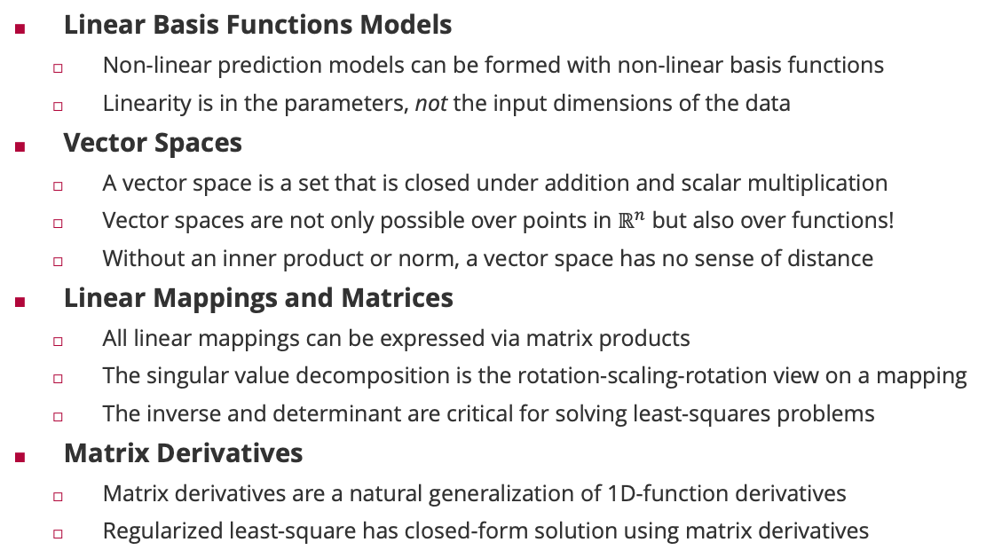
Summary
Linear Basis Functions Models
Non-linear prediction models can be formed with non-linear basis functions
Linearity is in the parameters, not the input dimensions of the data
Vector Spaces
A vector space is a set that is closed under addition and scalar multiplication
Vector spaces are not only possible over points in $ℝ^{n}$ but also over functions!
Without an inner product or norm, a vector space has no sense of distance
Linear Mappings and Matrices
All linear mappings can be expressed via matrix products
The singular value decomposition is the rotation-scaling-rotation view on a mapping
The inverse and determinant are critical for solving least-squares problems
Matrix Derivatives
Matrix derivatives are a natural generalization of 1D-function derivatives
Regularized least-square has closed-form solution using matrix derivatives

Slide 25
See you next week!

